Slide 1
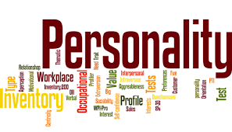
PERSONALITY

Slide 2
PERSONALITY
DERIVED from Latin Word “ Persona” means to speak through.
Behavior displayed in public
“Personality is how a person affects others and how he understands and views himself as well as the pattern of inner and outer measurable traits and the person situation interaction”__ By Fred Luthans

Slide 3
TRAITS OF PERSONALITY
Attribute of a person
Differentiate one individual from other
That appear constantly in variety of situation.

Slide 4
ALLPORT PERSONALITY TRAIT

Slide 5
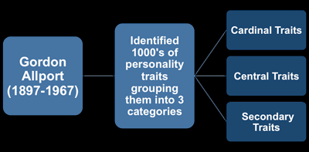

Slide 6
ALLPORT PERSONALITY TRAIT
Cardinal traits-If a trait dominates your personality and strongly influences your thoughts, feelings, and behaviors, it is a cardinal trait in Allport's system. They are so pervasive and defining of your personality that your name becomes synonymous with these traits. Allport suggested that very few people possess a cardinal trait and it can rarely be hidden.
If we refer to someone as Christ like, it means that he would sacrifices his own good for the benefit of others. For example, cardinal traits of Hitler and Mother Teresa were ruthlessness and selflessness.

Slide 7
ALLPORT PERSONALITY TRAIT
Central traits-Central traits come next in the hierarchy proposed by Allport and they are the characteristics that combine to shape most people's personalities. They are less pervasive and quite generalized characteristics of the individual. Allport believed that personality is generally determined by five to ten of these central traits. These are fairly consistent and are somewhat influenced by the environment you are in. You could find central traits such as outgoing, sentimental, attentive, sociable, or vivacious in the writing

Slide 8
ALLPORT PERSONALITY TRAIT
Secondary trait - These are characteristics seen only in certain circumstances (such as particular likes or dislikes that a very close friend may know). They must be included to provide a complete picture of human complexity.

Slide 9
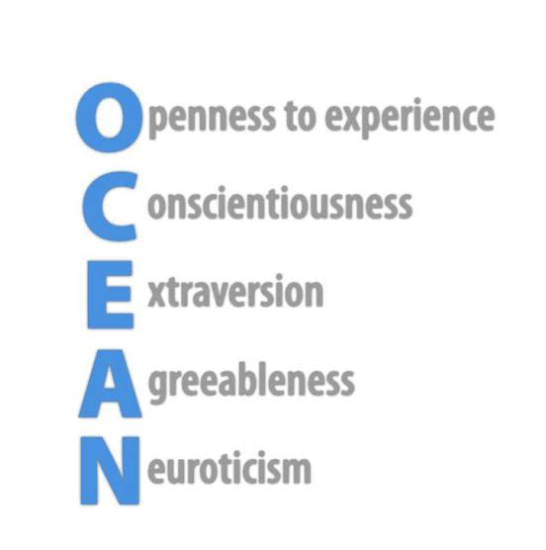
BIG FIVE TRAITS OF PERSONALITY

Slide 10
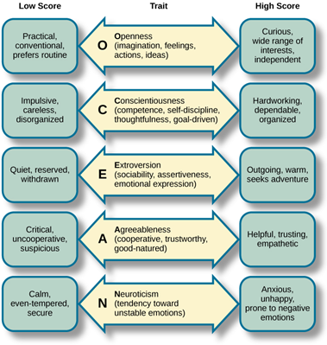

Slide 11
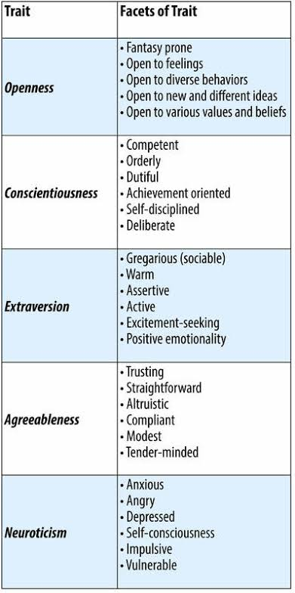

Slide 12
TYPE A vs. TYPE B
Type B personality is one which is less stress prone patient, relaxed and easy going.
Reflective and innovative
High
Even-tempered
Less-competitive
Is not affected by time constraints.
Type A personality is one which is stress prone, in a hurry, impatient and fast in whatever they do.
Sensitive and proactive
Patience level-Low
Temperament Short-tempered
Competition Highly-competitive
Time constraints -Encounters pressure because of time constraints

Slide 13
Other Important Traits
Authoritarianism
Machiavellianism
Type A and Type B
Self-Concept & Self-Esteem
Locus of Control

Slide 14
AUTHORITARIAN
Personality characterized by extreme obedience to, and dependence on, a powerful leader or father figure. These traits are accompanied by prejudicial, rigid, and tyrannical behavior against others, especially those who are inferior in rank, or vulnerable or weaker.

Slide 15
MACHIAVELLIANISM
Machiavellianism refers to a personality trait which sees a person so focused on their own interests they will manipulate, deceive, and exploit others to achieve their goals.

Slide 16
Someone with the trait of Machiavellianism will tend to have many of the following tendencies:
Only focused on their own ambition and interests
Prioritize money and power over relationships
Come across as charming and confident
Exploit and manipulate others to get ahead
Lie and deceive when required
Use flattery often
Lacking in principles and values

Slide 17
Self-Concept & Self Esteem
Self-concept is how an individual views who they are based on their habits, skills and temperament. In other words, it is the ability to reflect on one's own traits, skills and behavior.
Self-esteem is an attitude or view that an individual has about him or herself. It also refers to factors that we accept and value in ourselves and can be either negative or positive.

Slide 18
Locus of Control
Control can be defined as the power to determine outcomes by directly influencing actions, people and events. When we look at it that way, we can begin to see that there is no way to control everything in our lives. I'm not saying we cannot control anything, but put in the context of that definition, we have to step back and really analyze what we can and cannot control.
The word 'control' becomes even more interesting when we have the word locus, before it. You see, locus is defined as a position, point or place, or more specifically, a location where something occurs. A person's locus of control may be internal or external.

Slide 19
Internal vs. External Locus of Control
People who base their success on their own work and believe they control their life have an internal locus of control. In contrast, people who attribute their success or failure to outside influences have an external locus of control.
For example, let's say you're a person with an internal locus of control and you get a promotion at work or achieve some other type of success. You will probably attribute that positive end result to the work you put in. In other words, your success was a direct result of your hard work.
If, on the other hand, you have an external locus of control, you might attribute that promotion or success to external or environmental factors, such as luck, fate, timing, other people or some type of divine intervention.

Slide 20
Determinants of Performance
Heredity
Brain
Physical Features
Emotional Temperament
Interest
Motives
Family
Social Factors
Situational Factors

Slide 21
LEARNING
“Permanent change in the behavior of a person that occurs as a result of experience”. ____ S.P Robbins

Slide 22
Features of Learning
Involves change which are permanent in nature.
Changes are the result of experience, training or practices.
It is followed by reinforcement.

Slide 23
Principle of Learning
Trainee must be motivated to learn
Information must be meaningful
Learning must be reinforced
Feedback on Learning.

Slide 24
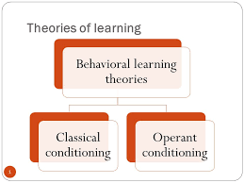
Theories of Learning
Classical Conditioning
Operant Conditioning
Cognitive Learning
Social Learning

Slide 25
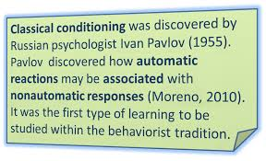

Slide 26
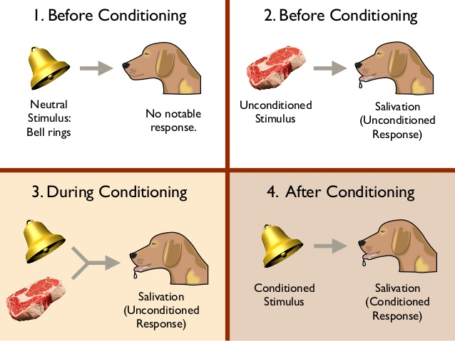

Slide 27
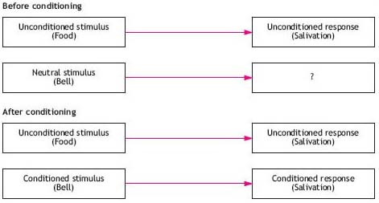

Slide 28
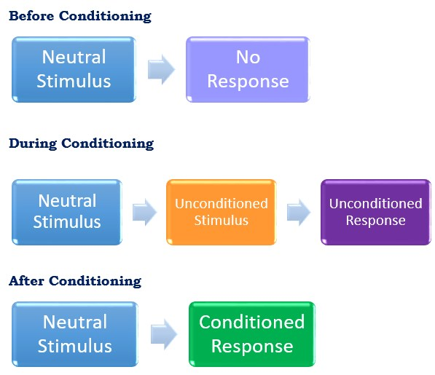

Slide 29
According to Classical Conditioning theory, Learning is a conditioned response which involves building up an association between a conditioned stimulus and an unconditioned stimulus.

Slide 30
OPERANT CONDITIONING
Operant conditioning (sometimes referred to as instrumental conditioning) is a method of learning that occurs through rewards and punishments for behavior.
Through operant conditioning, an association is made between a behavior and a consequence for that behavior.
For example, when a lab rat presses a blue button, he receives a food pellet as a reward, but when he presses the red button he receives a mild electric shock. As a result, he learns to press the blue button but avoid the red button.

Slide 31
OPERANT CONDITIONING
Skinner used the term operant to refer to any "active behavior that operates upon the environment to generate consequences."
In other words, Skinner's theory explained how we acquire the range of learned behaviors we exhibit each and every day.

Slide 32
OPERANT CONDITIONING
Skinner based his theory on “LAW OF EFFECT”.
According to this principle, actions that are followed by desirable outcomes are more likely to be repeated while those followed by undesirable outcomes are less likely to be repeated.

Slide 33
TYPES OF BEHAVIORS
Skinner distinguished between two different types of behaviors
Respondent behaviors are those that occur automatically and reflexively, such as pulling your hand back from a hot stove or jerking your leg when the doctor taps on your knee. You don't have to learn these behaviors, they simply occur automatically and involuntarily.

Slide 34
OPERANT CONDITIONING
Operant behaviors, on the other hand, are those under our conscious control. Some may occur spontaneously and others purposely, but it is the consequences of these actions that then influence whether or not they occur again in the future. Our actions on the environment and the consequences of that action make up an important part of the learning process.

Slide 35
Conclusion
The behavioral consequences that are rewarding increase the rate of response, while the aversive consequence decrease the rate of response.

